Slide 1




MEASI COLLEGE OF EDUCATION - 10209
Choolai, Chennai - 600112
Affiliated to Tamil Nadu Teachers Education University.

Slide 2
Creating Your Own Blog
R. LATHA
Assistant Professor
Department of Computer Science
MEASI College of Education

Slide 3
What is Blog?
A blog shortening of “weblog” is an online journal, or a personal diary or informational website.
It is a platform where a writer or even a group of writers share their views on an individual subject.
Displaying information in the reverse chronological order, with the latest posts appearing first.
This is the place to post your thoughts and opinions pertaining to a particular subject matter.

Slide 4
Blog
Title, the main title or headline of the post.
Body, main content of the post.
Permalink, URL of the full, individual article.
Post Date, date and time the post was published.

Slide 5
Blog (Optional)
Comments
Categories ( or tag) – subject that the entry discusses.
Trackback and or pingback – links to other sites that refers to the entry.

Slide 6
WIIFM
“What’s In It For Me”
Your reader will read your post looking for what’s in it for them.
    Make it valuable
    Keep it shot
    Avoid mistakes
    Keep it lively and Interesting

Slide 7
What is Blogging ?
Blogging is the set of many skills that one needs to run and control a blog.
Equipping web page with tools to make the process of writing, posting, linking, and sharing content easier on the internet.

Slide 8
What is the purpose of a blog?
Personal Blogs
Business Blogs
Educational Blogs
Corporate Blogs
Military Blogs
Political Blogs
House Blogs
Travels Blogs
Project Blogs
Etc…

Slide 9
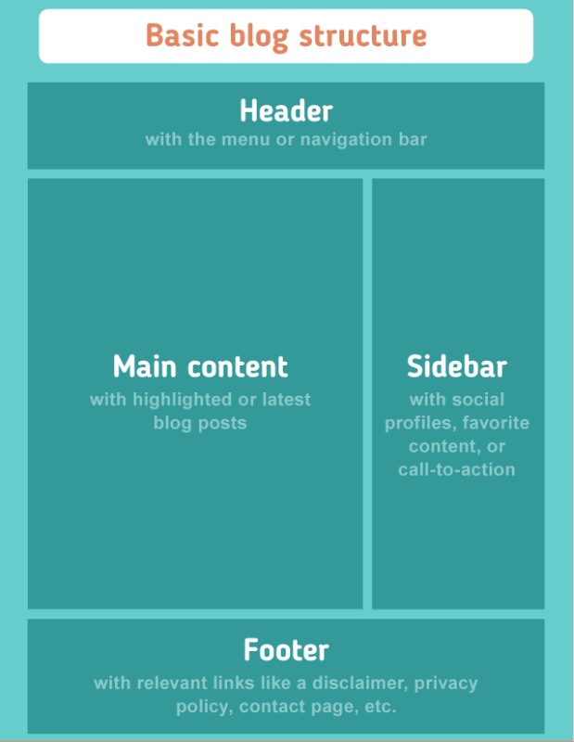
Blog Structure

Slide 10
Free Platform
  Blogger – www.blogger.com
  WordPress – www.wordpress.com
  TypePad - www.typepad.com
  FreeBlogIt - www.freeblogit.com
  Etc…

Slide 11
Want to start a blog on your own?

Slide 12
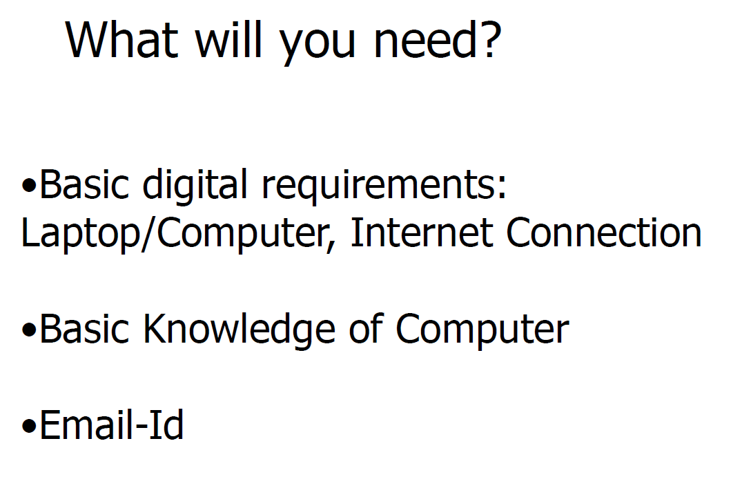

Slide 13
Step : 1
Create your mail ID
      Gmail.
      Yahoo mail
      Outlook
      Zoho mail
      AOL mail
      GMX mail
      Etc…

Slide 14
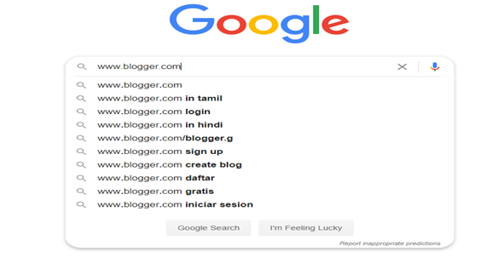
Step : 2
Open Google Search and type www.blogger.com

Slide 15
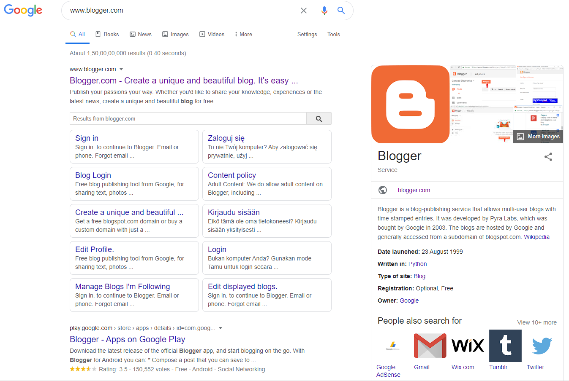
Step : 3 Click on Blogger.com Website

Slide 16
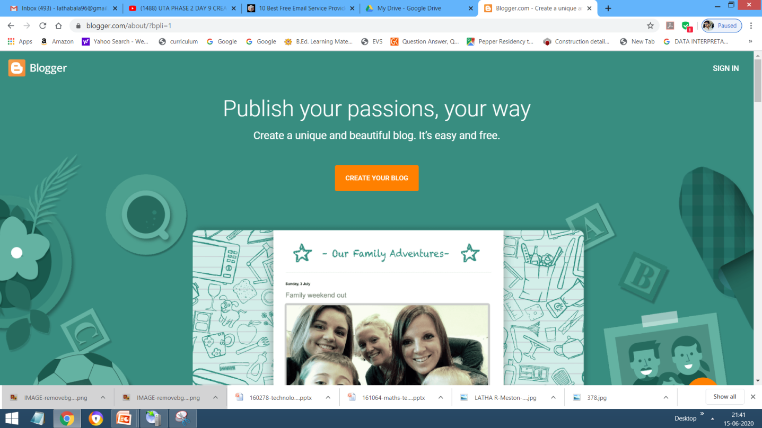
Step : 4 Signing Up for Blogger
Go to the web www.blogger.com
Click the orange button “Create Your Blog”

Slide 17
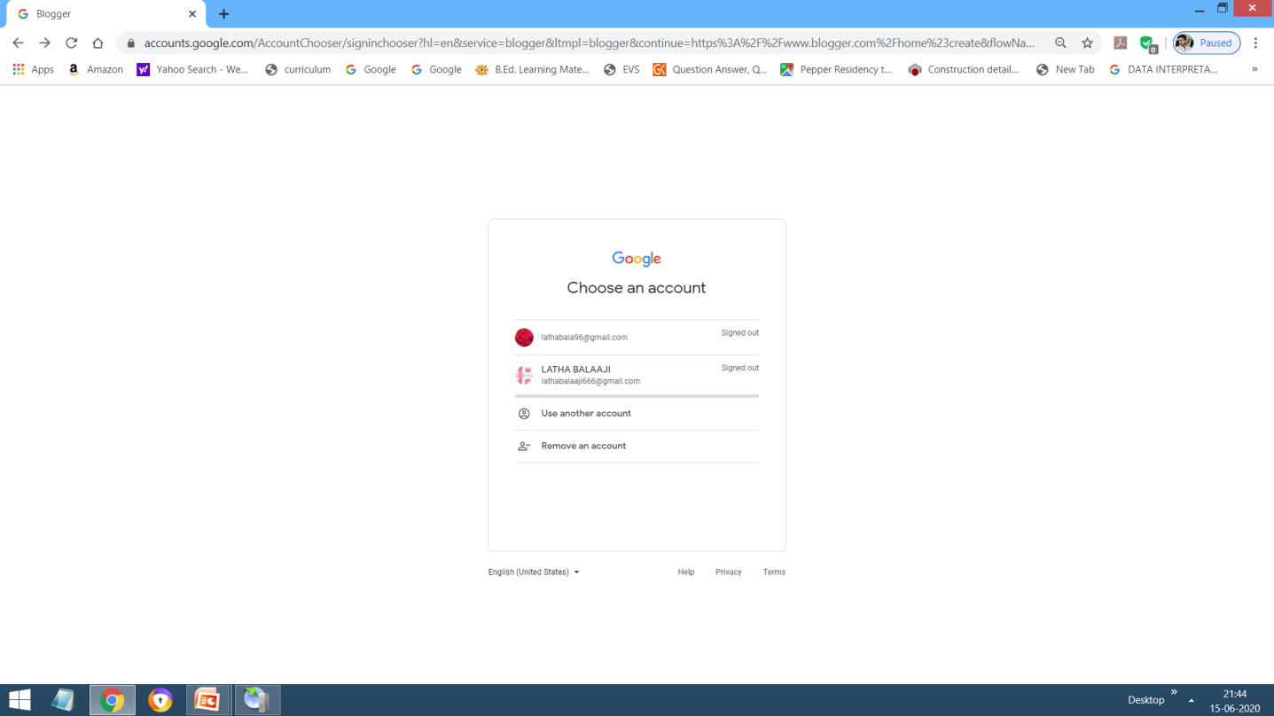
Step : 5 If you already have an blog account then click on Sign In, otherwise you can sign up with your existing gmail account

Slide 18
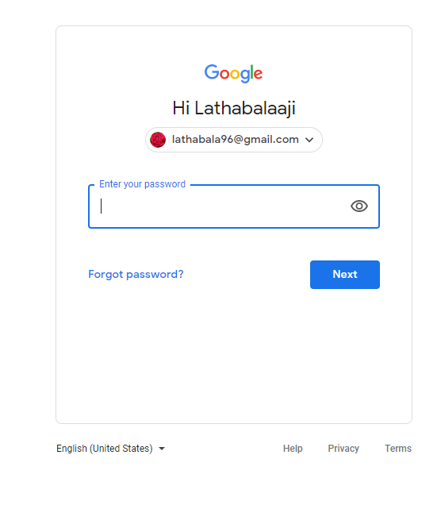
Step : 6

Slide 19
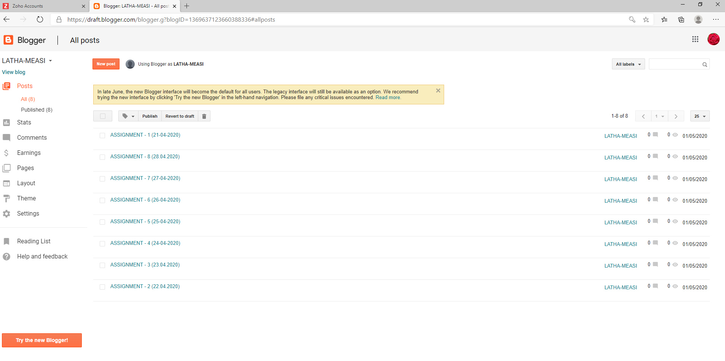
Step : 7

Slide 20
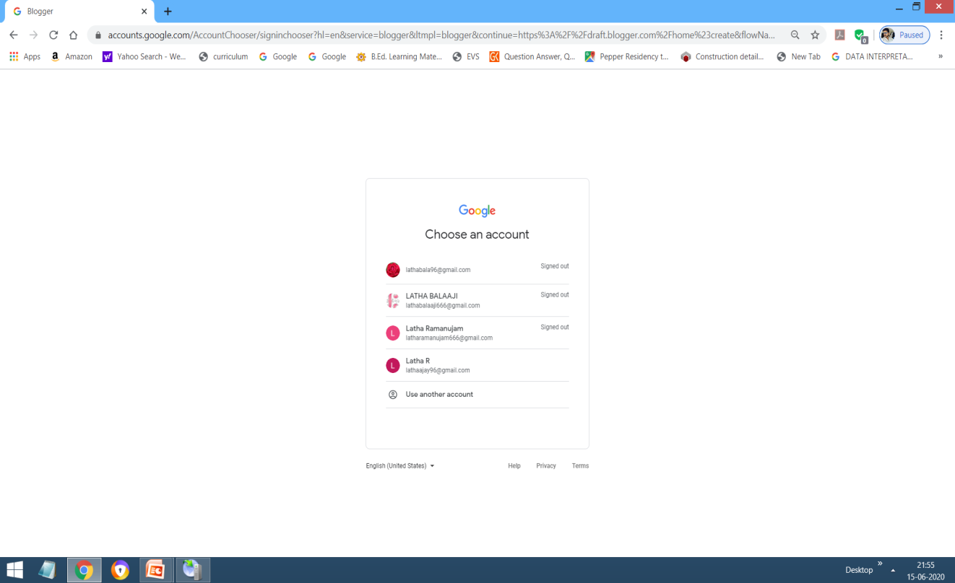
Step : 8 ( New User)
Enter Password

Slide 21
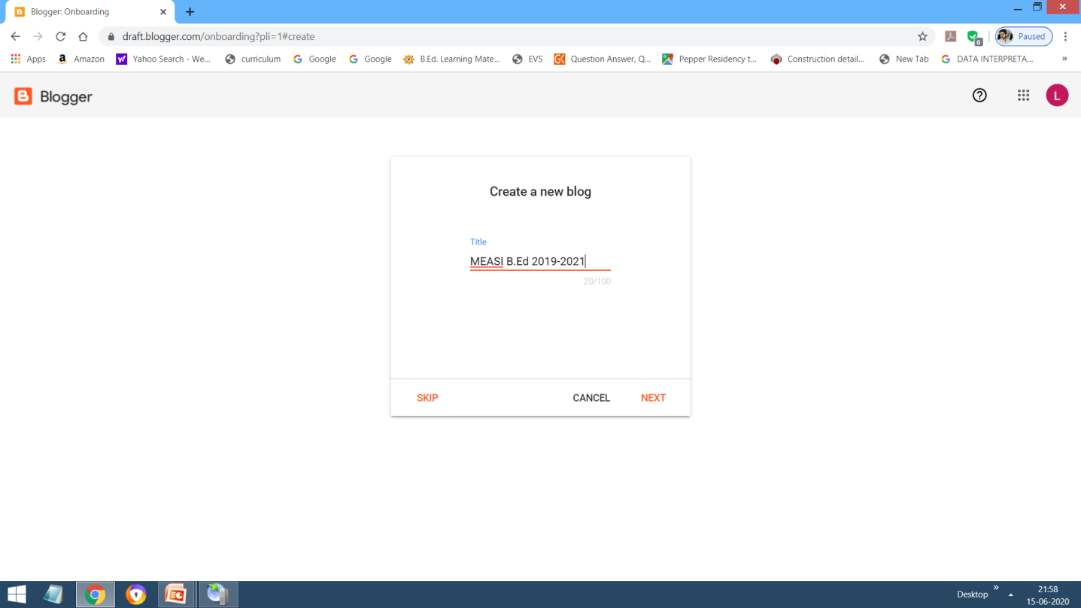
Step : 9 Create a New Blog
Type title of the blog.

Slide 22

Step : 10 Give new blog address according to your purpose

Slide 23
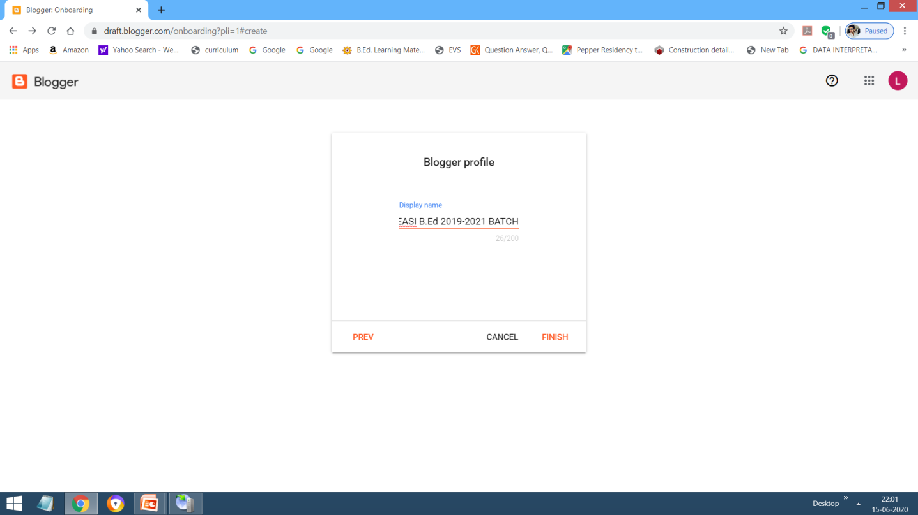
Step : 11 Display name

Slide 24
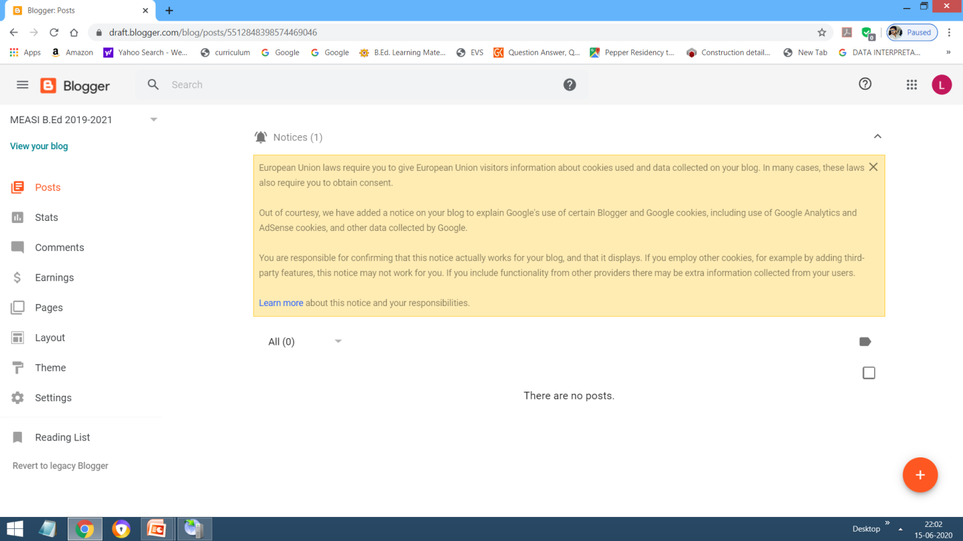
Your Blog is created now..

Slide 25
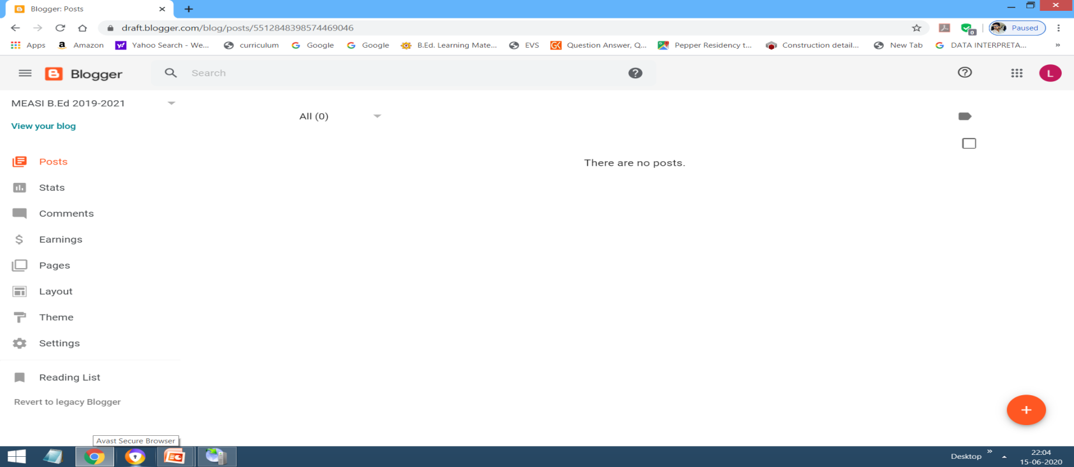
Blog is ready to process..
Click here

Slide 26
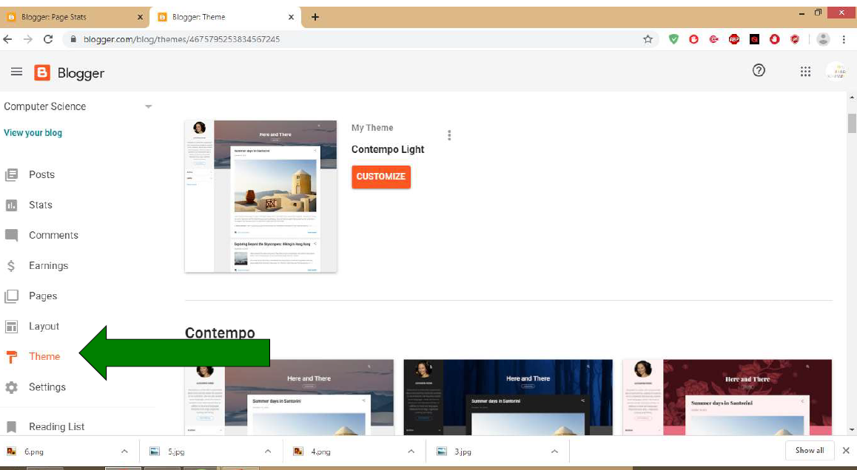
Select your Theme and Apply

Slide 27
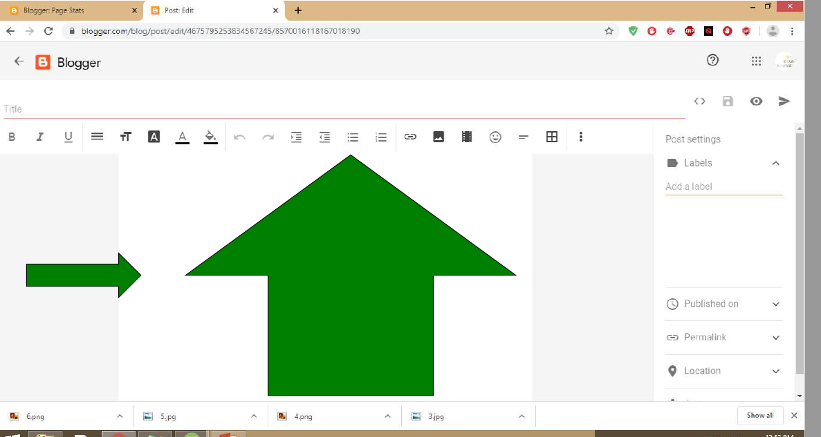
You can write insert images, Video from the formating tool bar

Slide 28
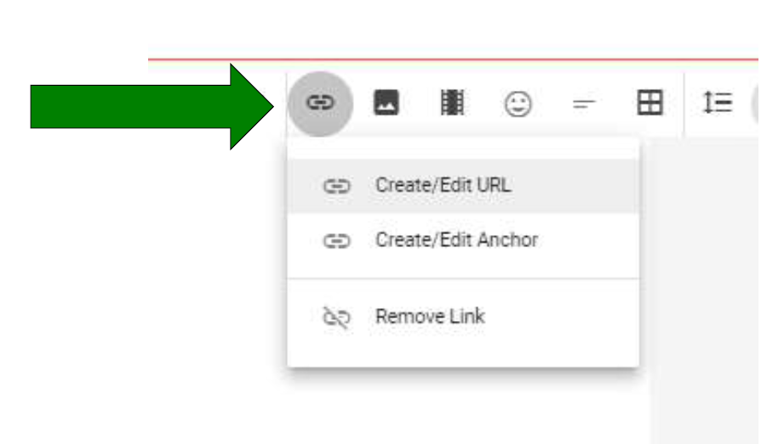
Create Link

Slide 29
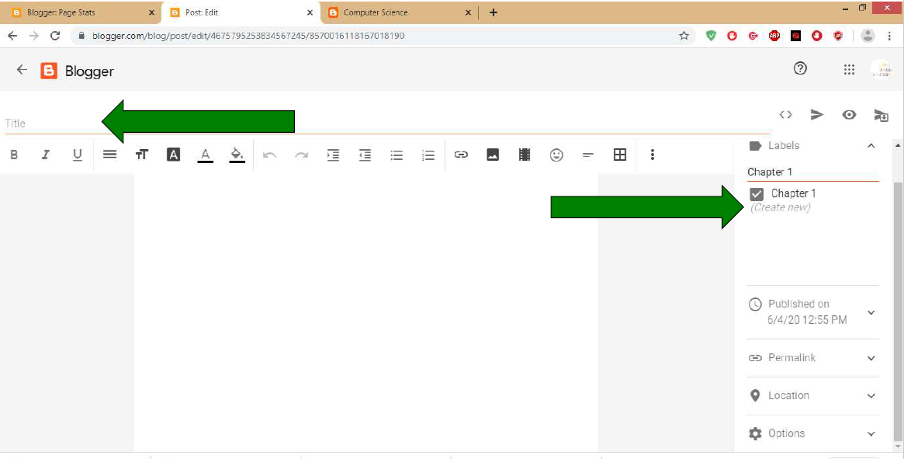
Type Title and Label for the contents

Slide 30
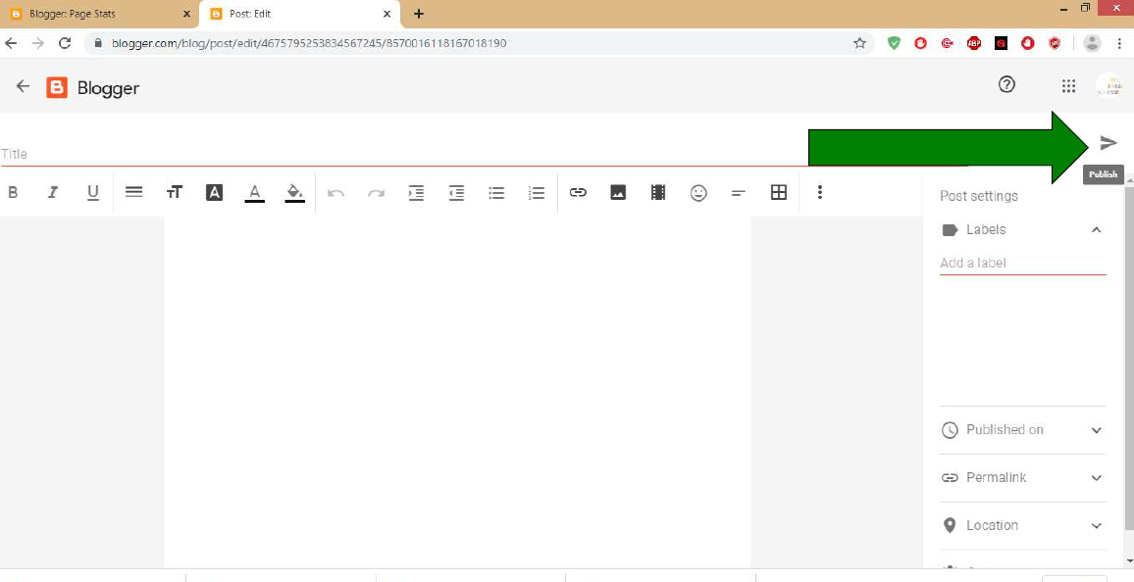
Click on Publish Button to view your blog

Slide 31
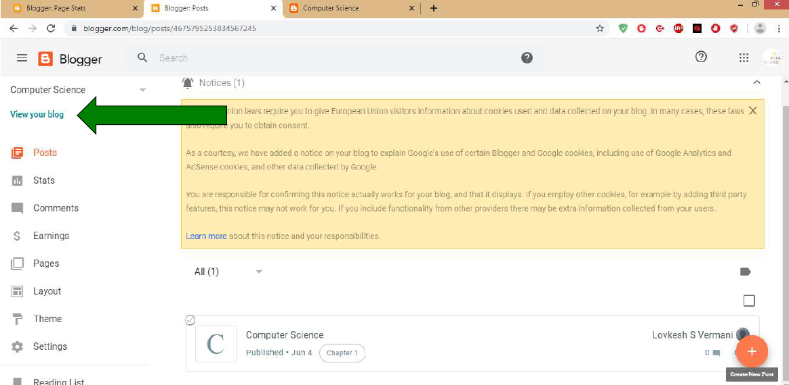
View Your Blog

Slide 32
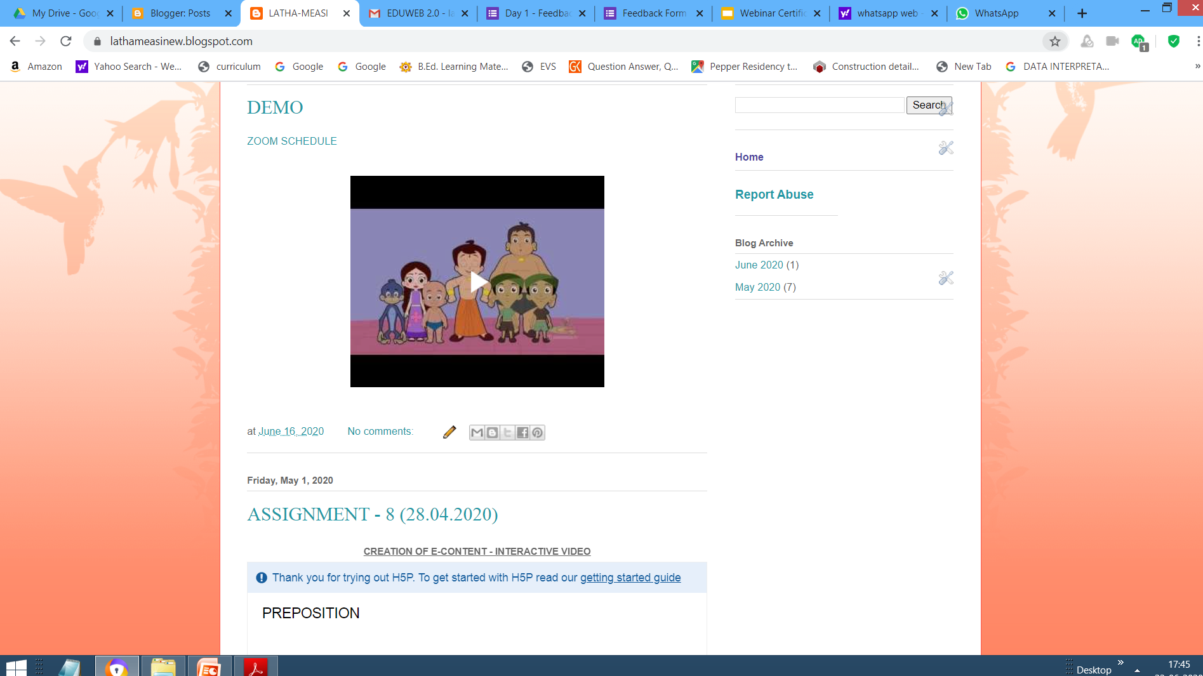
View your blog page

Slide 33
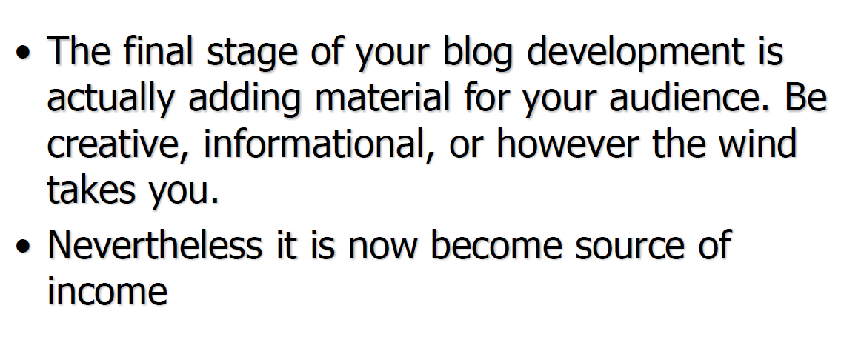
Posting your blog

Slide 34


